Slide 1

CIS 515 Final Project ASU RoomSense : Real Time Room Activity/Occupancy Monitor
Presented By Team 107:
Deeksha Lingaraju
Reeve George
Shriya
Manish Reddy
Yashwanth Guruswamy

Slide 2
Content
Introduction and Current Problem
Key Stakeholders
End-to-End Solution Lifecycle
Resources and Workflow Updates
Computer Vision Model
POC Demo
Model Training
Performance Metrics
Internal Validation / External Validation Plan
System Benefits and Scalability
Monitoring and Model Update Strategy
Outcome-Action Pairings
Bias, Limitations and Mitigations
Conclusion and Future Work

Slide 3
Introduction and Current Problem
ASU offers an automatic scheduling system for reserving study rooms, collaboration spaces, and advising offices, but bookings do not guarantee actual usage.
No-shows and overcrowding lead to inefficient space usage, lost opportunities, and student frustration.
Current systems track reservations but lack real-time insights into room occupancy or zone activity.
ASU RoomSense uses Computer Vision to monitor study spaces across campus and verify real-time usage, enhancing scheduling effectiveness.
Room Reservations No-Shows and Overcrowding Lack of Real-Time Insights
Booked rooms do not guarantee actual
occupancy or usage.
Frequent no-shows and overcrowding events are not detected in real-time.
Existing systems only manage reservations, not live room activity or space utilization.
Despite having automated scheduling systems, ASU lacks the ability to verify real-time room usage after a reservation. Traditional systems cannot detect no-shows, unexpected overcrowding, or active zone utilization inside reserved spaces.
RoomSense addresses this gap by automating occupancy and activity monitoring using Computer Vision.

Slide 4



Key Stakeholders
Facilities Managers
Student Services
Campus Scheduling Teams
Optimize space utilization by verifying actual room usage and detecting underutilized or overcrowded areas.
Ensure equitable access to study rooms and collaboration spaces, improving the student experience.
Support data-driven scheduling decisions by validating real usage patterns alongside reservation data.
RoomSense benefits multiple stakeholders by bridging the gap between room reservations and real-time usage.
By providing occupancy verification, live alerts, and zone-specific analytics, the system enhances campus operational efficiency, improves space allocation decisions, and supports a better learning environment for students.

Slide 5
End-to-End Solution Lifecycle
Problem Definition:
Problem: Many ASU departments struggle with tracking real-time occupancy in various spaces such as student centers, meeting rooms, lobbies, and advising offices. The absence of real-time data results in inefficient space usage, poor resource allocation, and insufficient space management. Current methods like manual sign-ins or swipe-ins are unreliable.
Scope: Develop a real-time occupancy monitoring system using computer vision to track room occupancy and zone utilization at ASU. The system will help manage space utilization by detecting people in specific zones within a room.
Value of the Solution: Addresses the challenge of inefficient space usage and the lack of real-time occupancy tracking across campus.
Data Acquisition and Preparation:
Data Collection: Webcam captures real-time footage of rooms for occupancy detection.
YOLOv5: We leverage a pre-trained YOLOv5 model (using PyTorch) for object detection, which has been trained on a large set of images, including detecting people in various environments.
Zone Definitions: Specific zones in each room are manually defined within the video frame (e.g., entry point, collaborative area, help desk). These zones are crucial for tracking activity and ensuring accurate zone-based occupancy monitoring.
Frame Consistency: Ensure that every frame is properly timestamped and that the person count and zone activity data are consistent across frames.

Slide 6
End-to-End Solution Lifecycle
3. Feature Engineering:
Person Count per Zone: Track how many people are present in each defined zone over time.
Time Stamps: Each frame's detection and zone data is associated with a timestamp for temporal analysis.
Alert Triggers: Prepare data based on predefined occupancy thresholds to trigger alerts when the room reaches maximum capacity or specific zones exceed activity limits.
4. Model Building and Evaluation:
Used YOLOv5 (pre-trained model) for people detection in real-time video feeds.
YOLOv5 is fine-tuned to detect people, focusing on accuracy and speed for real-time applications.
Fine-tuned the YOLOv5 model on a dataset containing meeting room images to improve detection accuracy in specific environments.
Accuracy: The system’s ability to correctly detect people and track occupancy in real-time.
Alert Accuracy: Timeliness and accuracy of the alert system when occupancy exceeds the predefined threshold.

Slide 7
End-to-End Solution Lifecycle
5. Deployment Monitoring and Maintenance:
Real-Time Monitoring: Continuous monitoring of system performance (e.g., processing speed, alert accuracy).
Monitor for any hardware failures or video processing delays.
Periodically update the software and model (e.g., incorporating better algorithms for detection, optimizing for different environments).
Error Logs: Ensure the system logs errors and issues for further troubleshooting and updates.
Consequences: Possible over-reliance on automated alerts could lead to situations where human judgment is still required. Additionally, some users may feel discomfort from being tracked, even without identifiable data.
6. Bias and Fairness Challenges:
Limited or unrepresentative training data may lead to biased model performance in varied environments.
Model may perform well in test environments (e.g., meeting rooms) but struggle with diverse room layouts or lighting conditions.
Inaccurate detection of people in certain zones (e.g., near the camera vs. far from it) may skew activity tracking and resource allocation.
Capturing real-time video could raise privacy issues, even without facial recognition, affecting trust and fairness.

Slide 8
Estimated Resources and Workflow Updates
Estimated Resources Based on Project Scope:
People: 1–2 developers to set up, maintain, and troubleshoot the CV system; 1 project coordinator for oversight and stakeholder communication.
Systems: Standard webcam feed installed in study rooms; YOLOv5 open-source model and OpenCV libraries for detection and tracking.
Computational: A GPU-enabled laptop or local server capable of real-time video frame processing and alert generation.
Workflow Updates and Costs:
Setup :
Camera installation, zone calibration, and initial model integration testing.
Ongoing Maintenance:
Regular detection accuracy checks; adjusting model thresholds or zone layouts as room usage patterns change.
Operational Impact:
Minimal overhead if integrated into existing IT support; basic staff training needed to interpret occupancy reports and respond to alerts.

Slide 9

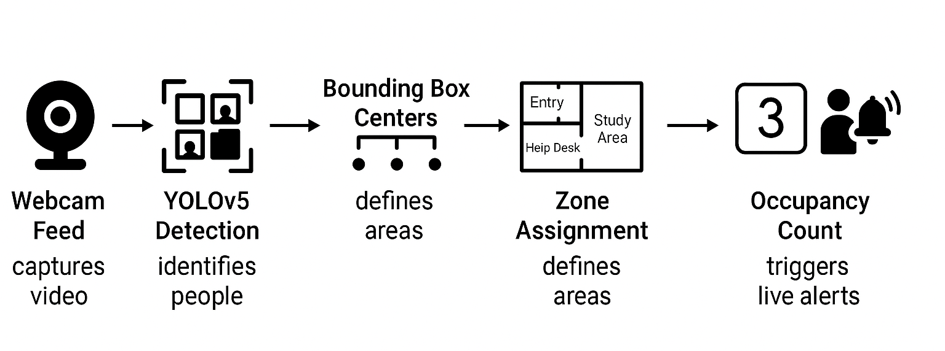
How Our Solution Uses Computer Vision (CV)
RoomSense uses CV to detect people in real-time using a webcam feed.
A pre-trained YOLOv5 model identifies and localizes "person" objects in each frame.
Detection outputs (bounding boxes) are mapped to predefined room zones.
Enables real-time occupancy tracking, zone activity monitoring, and crowding alerts.

Slide 10
Why Computer Vision is Essential to RoomSense
OpenCV Responsibilities
Manual monitoring is inefficient, error-prone, and non-scalable.
Badge swipes and entry systems only capture entry/exit — not real usage or zone activity.
Passive sensors (PIR) detect presence but cannot differentiate zones or group sizes.
CV provides fine-grained, real-time, zone-specific spatial awareness.
Without CV, verifying room occupancy and detecting overcrowding would not be possible.
Captures live video frames from webcam
Preprocesses frames (resizing, color conversion)
Displays frames with real-time bounding boxes
Saves snapshots and frame logs
YOLOv5s Responsibilities
Real-time detection of "person" objects
Maps detections to predefined room zones
Triggers real-time occupancy alerts

Slide 11
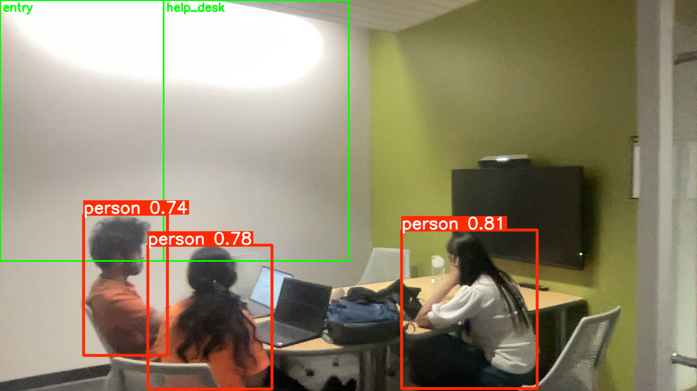
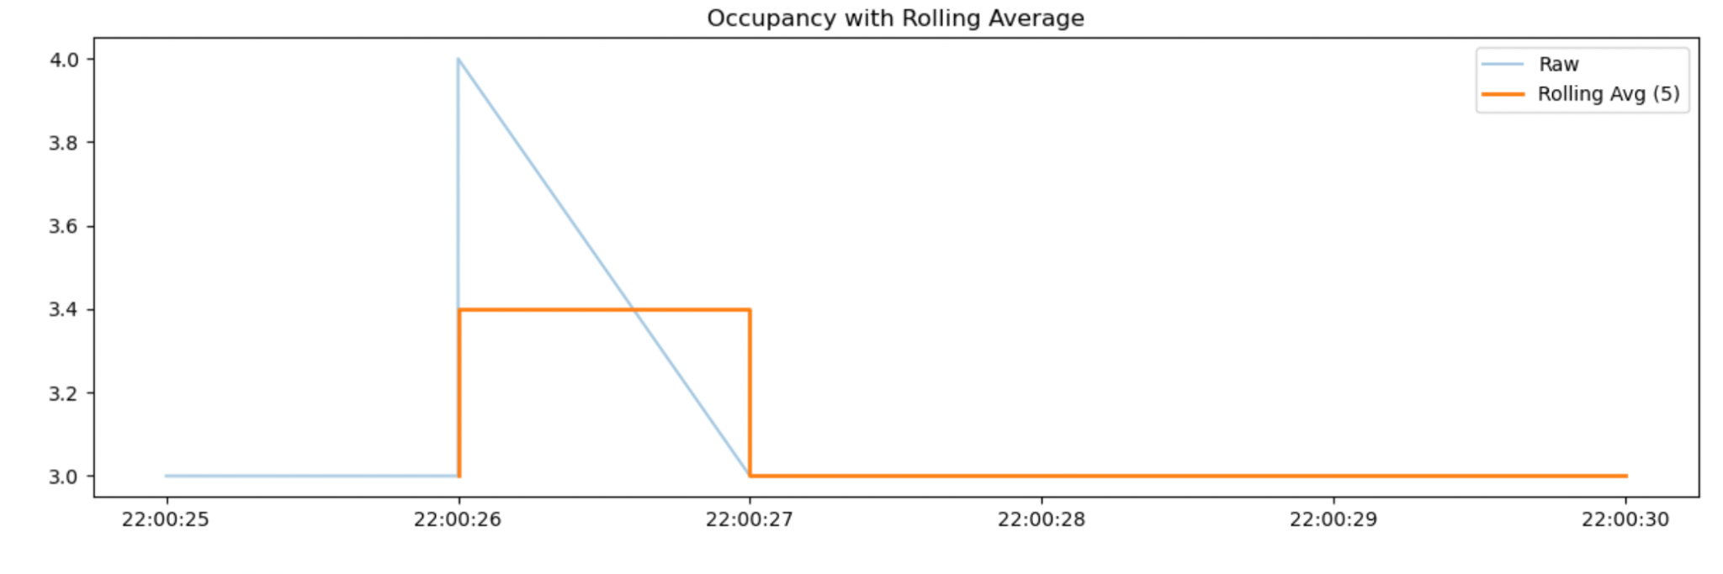
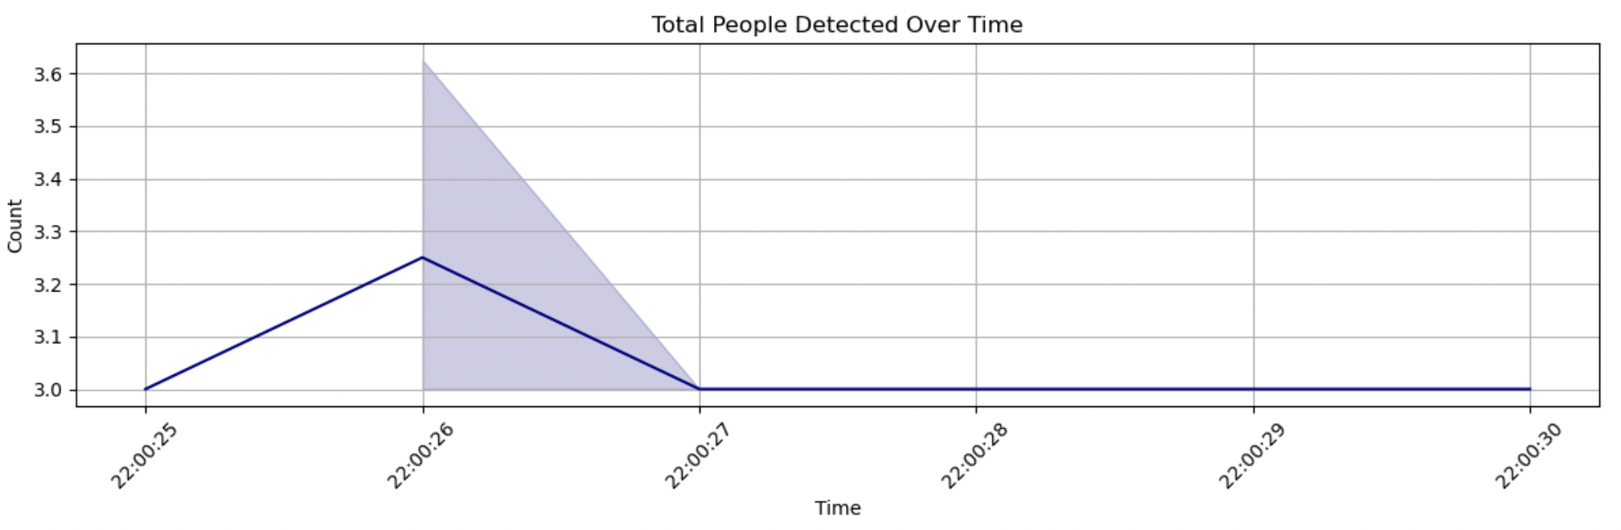
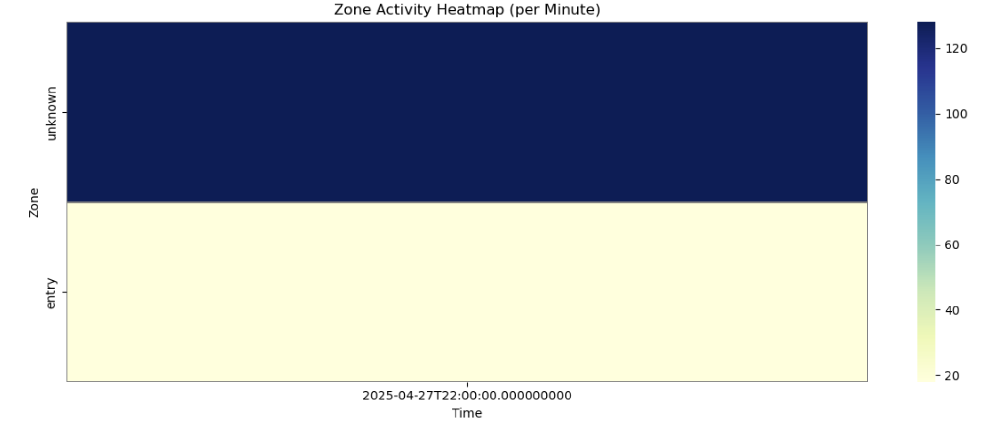
Proof-Of-Concept Demo

Slide 12
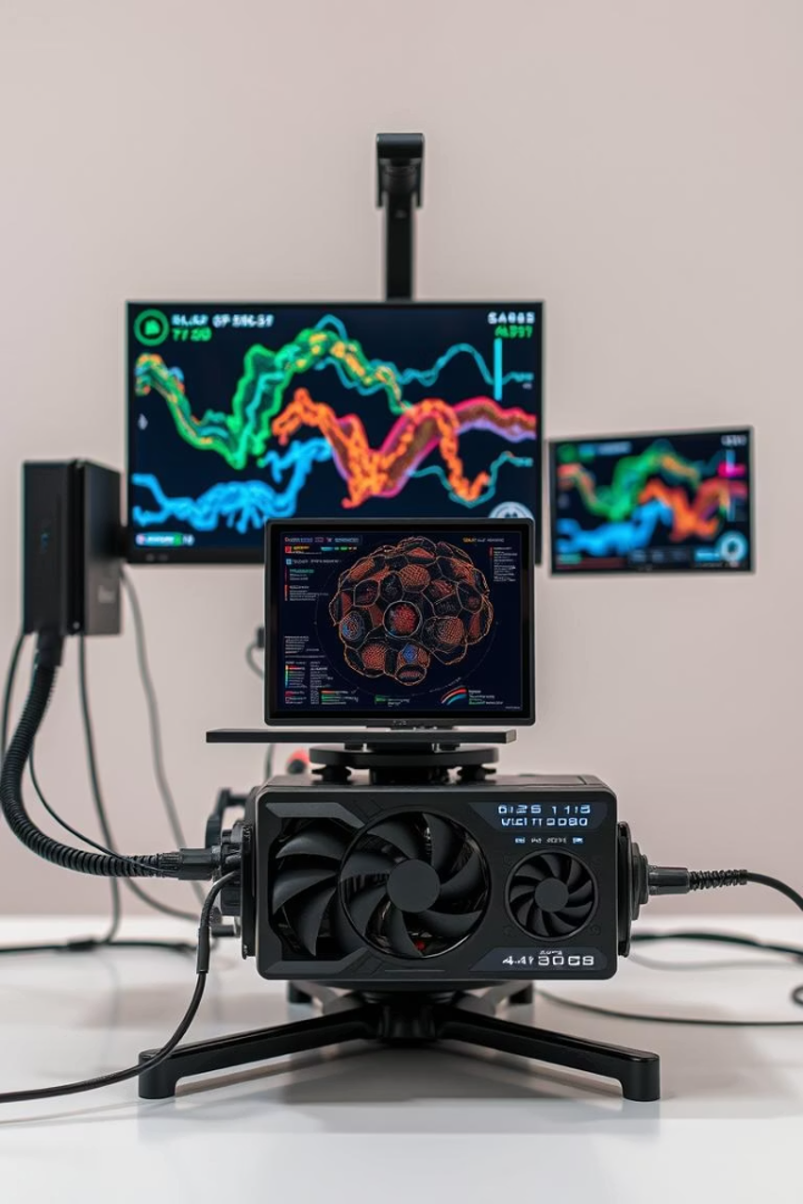

Model Training Details
Pre-trained YOLOv5s Model
Trained on COCO dataset with over 330,000 labeled images.
Training Approach
Utilizes transfer learning with heavy data augmentation including rotation, flipping, and color adjustments. Optimized using SGD and Mosaic augmentation.
Hardware
Training performed on high-end GPUs like NVIDIA V100 and RTX 3090.

Slide 13
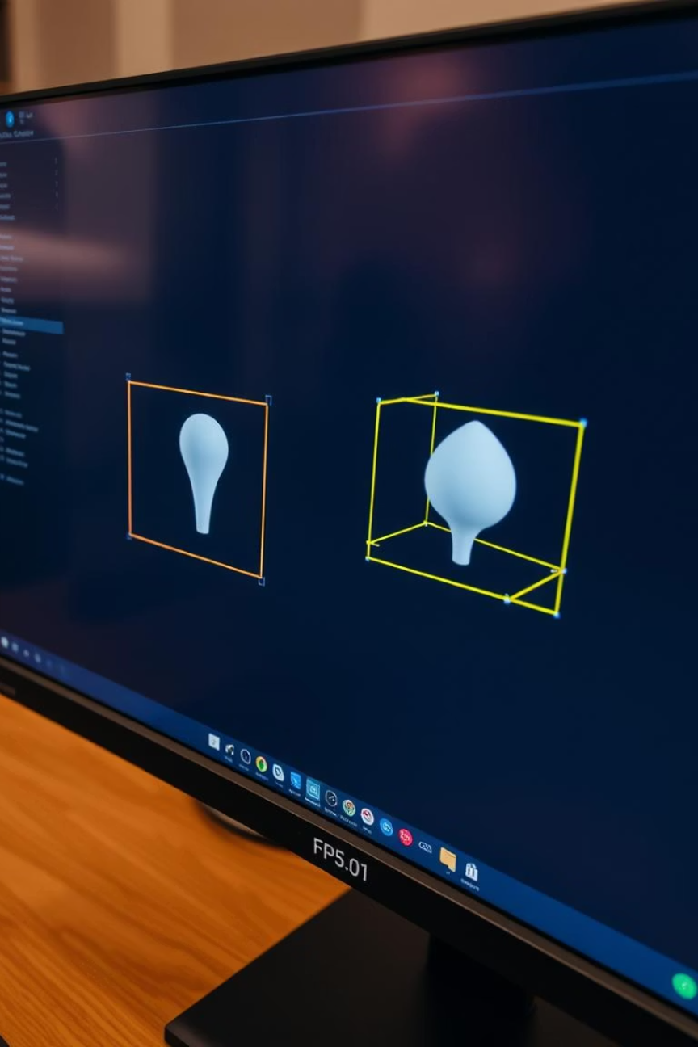

Performance Metrics
Accuracy
Detection Accuracy for person class exceeds 85%, with internal validation showing ~92% accuracy.
Speed
Achieves 140 FPS on GPU and approximately 15 FPS on standard CPU (MacBook M1).
Zone Mapping
Achieves 140 FPS on GPU and approximately 15 FPS on standard CPU (MacBook M1).

Slide 14
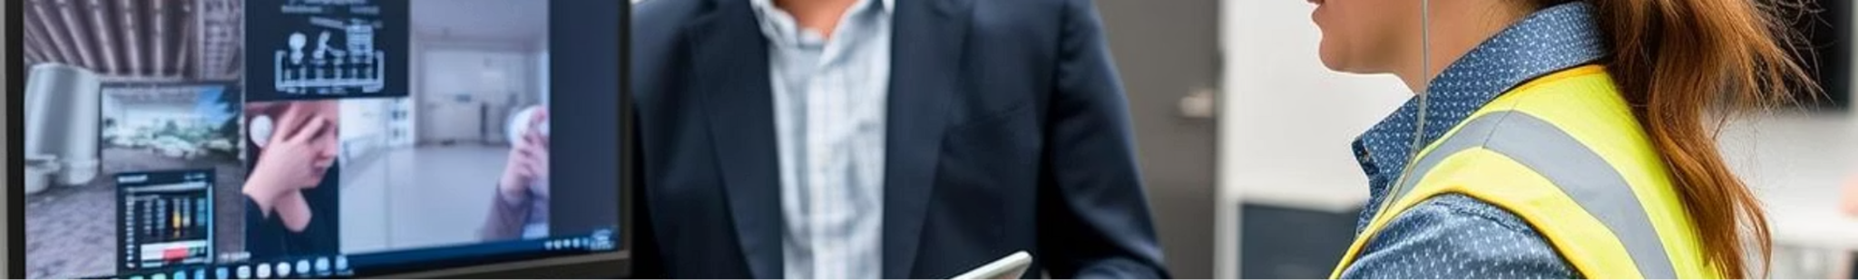
Internal Validation Process
Manual Headcount Comparison
Live webcam feeds were cross-checked with manual counts to verify detection accuracy.
Occupancy and Zone Validation
Detected occupancy was compared with ground truth, and zone mapping accuracy was measured.
Performance Measurement
Frames per second and false positive rates were monitored to ensure real-time operation.

Slide 15
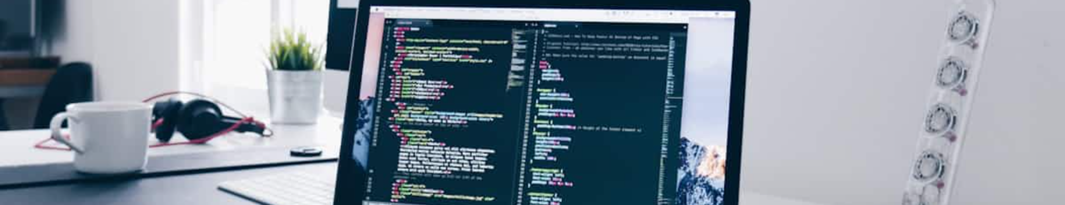

External Validation Plan
Pre-Deployment Testing
Simulated occupancy tests with varying crowd sizes and confusion matrix generation.
Post-Deployment Audits
Random manual audits during operational hours and cross-verification with RoomSense logs.
User Feedback
Collecting input from facility managers and security teams for continuous improvement.
Fine-Tuning
Ongoing adjustments based on discrepancies observed during audits and feedback.

Slide 16
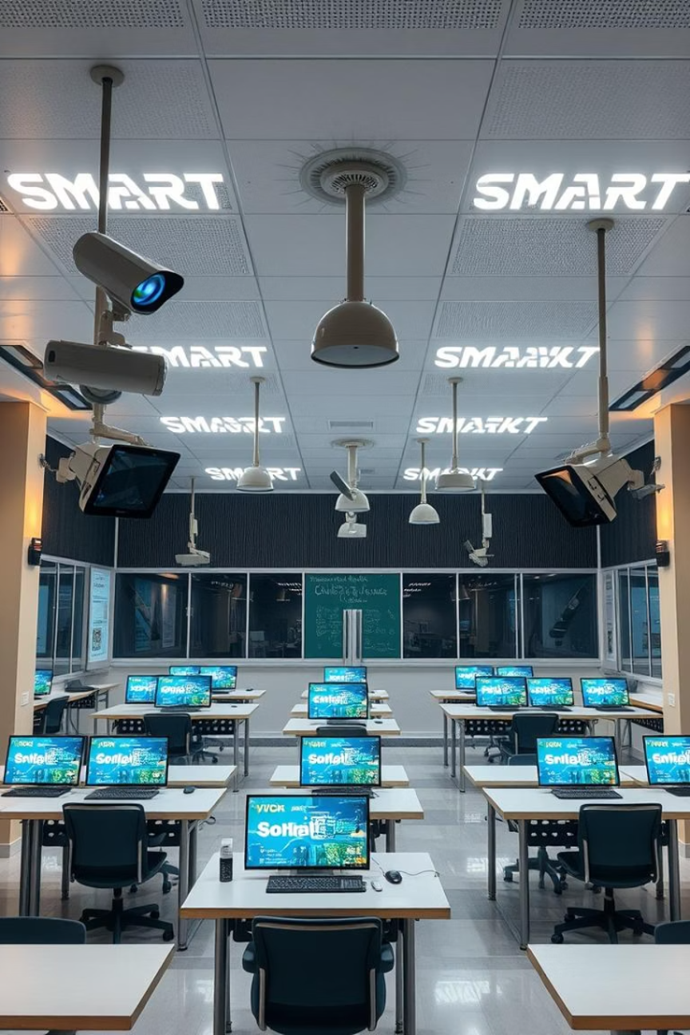

System Benefits and Scalability
Efficient Monitoring
Lightweight and fast pipeline enables real-time people tracking with minimal hardware requirements.
Scalable Solution
Designed for easy expansion to other smart campus applications and environments.
High Accuracy
Reliable detection and zone mapping ensure precise occupancy monitoring for classrooms.

Slide 17
Monitoring & Model Update Strategy
Monitoring Post-Deployment:
Logs occupancy counts and zone data into CSV during runtime.
Snapshots during alerts act as a manual validation tool for overcapacity events.
Post-monitoring analysis includes:
Line chart of occupancy over time (via Matplotlib).
Basic statistical summaries printed to the console.
Update Plan:
Continue with manual snapshot reviews to validate detection accuracy.
Optionally enhance with automated report generation or integrate dashboards in future versions (e.g., move towards Streamlit).

Slide 18
Outcome-Action Pairings
Detailed Outcome-Action Table:
Model Outcome | Action Taken | Cost Consideration
True Positive | Accurate detection → counts & alerts logged | Expected system behavior, no extra cost
False Positive | Unnecessary alert or incorrect tagging | Minor → temporary user inconvenience
False Negative | Missed detection → under-reported occupancy | Critical → Safety risk if overcrowded
True Negative | No detection, no action | No action, no cost
Cost-Benefit Summary:
The system’s lightweight hardware requirement (webcam + CPU) offers a low-cost solution with significant operational benefits in safety and space optimization
Action Adjustments:
Overcapacity detection: Triggers in-frame alert text + snapshot saving.
The cost analysis and impact of FP/FN remain the same.

Slide 19
Bias, Limitations & Mitigations
Bias Sources:
Dataset Bias:
YOLOv5 trained on COCO dataset; may underperform in ASU-specific environments (e.g., low-light, occlusions, informal postures).
Framing Bias:
Fixed zones assume static layouts; room changes can impact accuracy.
Camera angles can introduce blind spots.
Mitigation Strategies:
Snapshot validation: Snapshots saved every 15 frames during alerts enable manual review of detections (check FPs/FNs).
Deployment adjustments:
Optimize camera placement & lighting.
Allow manual redefinition of zones as room layouts evolve.
Future mitigation:
Fine-tune YOLOv5 with ASU-specific images.
Explore dynamic zone configurations.
Known Limitations:
Lighting Sensitivity: Accuracy drops in low-light or high-contrast environments.
Hardware Constraints: Real-time performance can lag on non-GPU systems.
Simple Zone Layouts: Current rectangular zones may not suit complex room designs.
Planned Mitigations:
Deploy high-quality webcams with low-light compensation.
Optimize camera angles and explore multi-camera setups for larger spaces.
Test lighter models (YOLOv5n) for hardware-limited environments. Enhance zone flexibility to support more complex layouts.

Slide 20
Conclusion
Solution Summary:
ASU RoomSense leverages Computer Vision to monitor real-time room occupancy and zone activity, complementing scheduling systems by verifying actual space usage.
Key Findings:
CV-based detection provides fine-grained spatial awareness, real-time occupancy tracking, and actionable insights for campus space optimization.
Limitations:
System accuracy may vary with lighting conditions, crowded scenes, and camera positioning; real-time performance depends on hardware capabilities.
Possible Extensions:
Integration with ASU's scheduling systems for live utilization dashboards.
Model fine-tuning for campus-specific environments
Enhanced privacy safeguards and on-device (edge) processing.

Slide 21
Future Work
Planned Enhancements:
Fine-tune YOLOv5 on ASU-specific data:
Collect images from ASU campus environments to retrain the model for better context adaptation (e.g., unique lighting, room setups).
Expand to multi-camera systems:
Deploy multiple camera feeds to cover larger or complex spaces (e.g., lecture halls, open areas).
Integrate predictive analytics:
Use historical occupancy data to forecast peak usage times for proactive space management.
Dynamic zone configurations:
Enable adaptive or AI-suggested zones based on real-time movement patterns and space utilization heatmaps.
Automate reporting and alerts:
Extend the current snapshot & CSV logging to generate automated reports and email alerts for facility managers.

Slide 22
Task Ownership/Contribution + References Used
Reeve George | Worked on initial project idea creation, CV model integration, computational resource/workflow, along with development of core slides creation for presentation
Deeksha Lingaraju | Worked on Advanced analysis of occupancy on the test data to derive the metrics,along with End to end solution lifecycle, POC demo slides.
Shriya | Developed real-time tracking code using OpenCV, Logged and analyzed occupancy data, performance metrics, system benefits and scalability.
Yashwanth Guruswamy | Conducted live tests, validated zone detection accuracy, and fine-tuned thresholds. with multiple test cases, developed core slides for presentation
Manish Reddy | Slides creation for presentation
References :
Ultralytics YOLOv5 Documentation: https://docs.ultralytics.com/
YOLOv5 GitHub Repository: https://github.com/ultralytics/yolov5
OpenCV Documentation: https://docs.opencv.org/
cvlib Python Library: https://www.cvlib.net/

